Slide 1
Unit – 2
Computer Networks

Slide 2
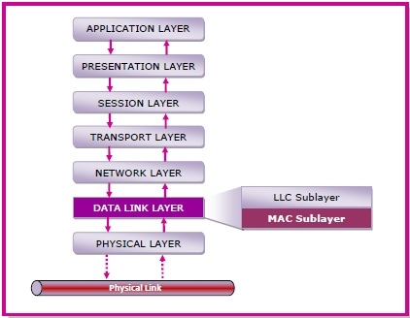
The medium access control (MAC) is a sublayer of the data link layer of the open system interconnections (OSI) reference model for data transmission. It is responsible for flow control and multiplexing for transmission medium. It controls the transmission of data packets via remotely shared channels. It sends data over the network interface card.
MAC Layer in the OSI Model
The Open System Interconnections (OSI) model is a layered networking framework that conceptualizes how communications should be done between heterogeneous systems.
The data link layer is the second lowest layer. It is divided into two sublayers −
The logical link control (LLC) sublayer
The medium access control (MAC) sublayer
The following diagram depicts the position of the MAC layer −

Slide 3
Functions of MAC Layer
• It provides an abstraction of the physical layer to the LLC and upper layers of the OSI network.
• It is responsible for encapsulating frames so that they are suitable for transmission via the physical medium.
• It resolves the addressing of source station as well as the destination station, or groups of destination stations.
• It performs multiple access resolutions when more than one data frame is to be transmitted. It determines the channel access methods for transmission.
• It also performs collision resolution and initiating retransmission in case of collisions.
• It generates the frame check sequences and thus contributes to protection against transmission errors.

Slide 4
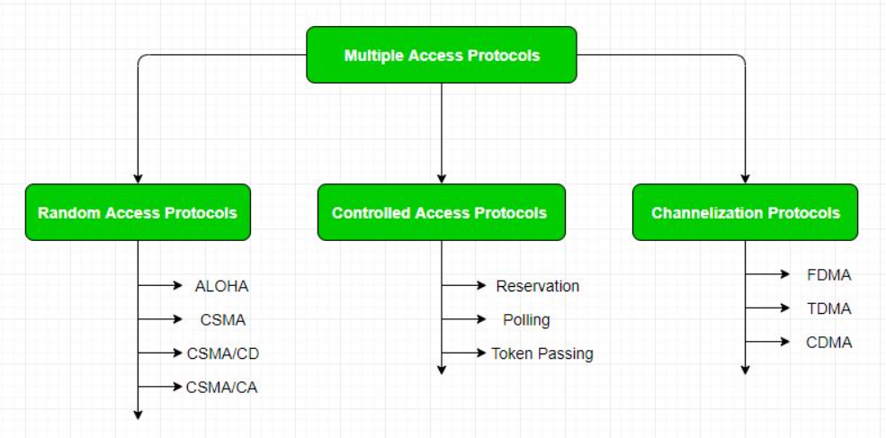

Slide 5
Multiple Access Control –
Random Access Protocol: In this, all stations have same superiority that is no station has more priority than another station. Any station can send data depending on medium’s state( idle or busy). It has two features:
There is no fixed time for sending data
There is no fixed sequence of stations sending data
The Random access protocols are further subdivided as:
(1) ALOHA – It was designed for wireless LAN but is also applicable for shared medium. In this, multiple stations can transmit data at the same time and can hence lead to collision and data being garbled.
Pure Aloha: When a station sends data it waits for an acknowledgement. If the acknowledgement doesn’t come within the allotted time then the station waits for a random amount of time called back-off time (Tb) and re-sends the data. Since different stations wait for different amount of time, the probability of further collision decreases.
Slotted Aloha: It is similar to pure aloha, except that we divide time into slots and sending of data is allowed only at the beginning of these slots. If a station misses out the allowed time, it must wait for the next slot. This reduces the probability of collision.

Slide 6
(b) CSMA – Carrier Sense Multiple Access ensures fewer collisions as the station is required to first sense the medium (for idle or busy) before transmitting data. If it is idle then it sends data, otherwise it waits till the channel becomes idle. However there is still chance of collision in CSMA due to propagation delay. For example, if station A wants to send data, it will first sense the medium.If it finds the channel idle, it will start sending data. However, by the time the first bit of data is transmitted (delayed due to propagation delay) from station A, if station B requests to send data and senses the medium it will also find it idle and will also send data. This will result in collision of data from station A and B.
CSMA access modes-
1-persistent: The node senses the channel, if idle it sends the data, otherwise it continuously keeps on checking the medium for being idle and transmits unconditionally(with 1 probability) as soon as the channel gets idle.
Non-Persistent: The node senses the channel, if idle it sends the data, otherwise it checks the medium after a random amount of time (not continuously) and transmits when found idle.
P-persistent: The node senses the medium, if idle it sends the data with p probability. If the data is not transmitted ((1-p) probability) then it waits for some time and checks the medium again, now if it is found idle then it send with p probability. This repeat continues until the frame is sent. It is used in Wifi and packet radio systems.
O-persistent: Superiority of nodes is decided beforehand and transmission occurs in that order. If the medium is idle, node waits for its time slot to send data.

Slide 7
(c) CSMA/CD – Carrier sense multiple access with collision detection. Stations can terminate transmission of data if collision is detected. For more details refer – Efficiency of CSMA/CD
(d) CSMA/CA – Carrier sense multiple access with collision avoidance. The process of collisions detection involves sender receiving acknowledgement signals. If there is just one signal(its own) then the data is successfully sent but if there are two signals(its own and the one with which it has collided) then it means a collision has occurred. To distinguish between these two cases, collision must have a lot of impact on received signal. However it is not so in wired networks, so CSMA/CA is used in this case.
CSMA/CA avoids collision by:
Interframe space – Station waits for medium to become idle and if found idle it does not immediately send data (to avoid collision due to propagation delay) rather it waits for a period of time called Interframe space or IFS. After this time it again checks the medium for being idle. The IFS duration depends on the priority of station.
Contention Window – It is the amount of time divided into slots. If the sender is ready to send data, it chooses a random number of slots as wait time which doubles every time medium is not found idle. If the medium is found busy it does not restart the entire process, rather it restarts the timer when the channel is found idle again.
Acknowledgement – The sender re-transmits the data if acknowledgement is not received before time-out.

Slide 8
2. controlled access-
controlled access, the stations seek information from one another to find which station has the right to send. It allows only one node to send at a time, to avoid collision of messages on shared medium. The three controlled-access methods are:
Reservation
Polling
Token Passing
I. Reservation
In the reservation method, a station needs to make a reservation before sending data.
The time line has two kinds of periods:
Reservation interval of fixed time length
Data transmission period of variable frames.
If there are M stations, the reservation interval is divided into M slots, and each station has one slot.
Suppose if station 1 has a frame to send, it transmits 1 bit during the slot 1. No other station is allowed to transmit during this slot.
In general, i ^{th} station may announce that it has a frame to send by inserting a 1 bit into i ^{th} slot. After all N slots have been checked, each station knows which stations wish to transmit.
The stations which have reserved their slots transfer their frames in that order.
After data transmission period, next reservation interval begins.
Since everyone agrees on who goes next, there will never be any collisions.

Slide 9
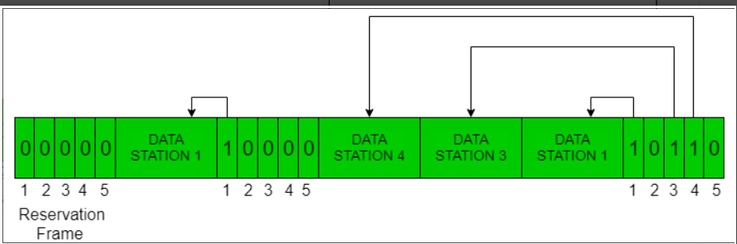
The following figure shows a situation with five stations and a five-slot reservation frame. In the first interval, only stations 1, 3, and 4 have made reservations. In the second interval, only station 1 has made a reservation.

Slide 10
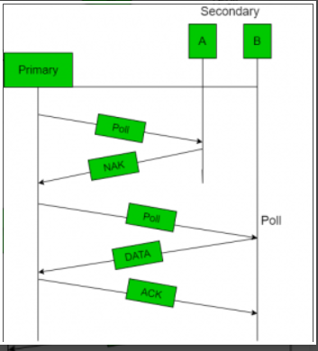
II. Polling
Polling process is similar to the roll-call performed in class. Just like the teacher, a controller sends a message to each node in turn.
In this, one acts as a primary station(controller) and the others are secondary stations. All data exchanges must be made through the controller.
The message sent by the controller contains the address of the node being selected for granting access.
Although all nodes receive the message but the addressed one responds to it and sends data, if any. If there is no data, usually a “poll reject”(NAK) message is sent back.

Slide 11
III. Token Passing
In token passing scheme, the stations are connected logically to each other in form of ring and access of stations is governed by tokens.
A token is a special bit pattern or a small message, which circulate from one station to the next in some predefined order.
In Token ring, token is passed from one station to another adjacent station in the ring whereas incase of Token bus, each station uses the bus to send the token to the next station in some predefined order.
In both cases, token represents permission to send. If a station has a frame queued for transmission when it receives the token, it can send that frame before it passes the token to the next station. If it has no queued frame, it passes the token simply.
There exists problems like duplication of token or token is lost or insertion of new station, removal of a station, which need be tackled for correct and reliable operation of this scheme.

Slide 12
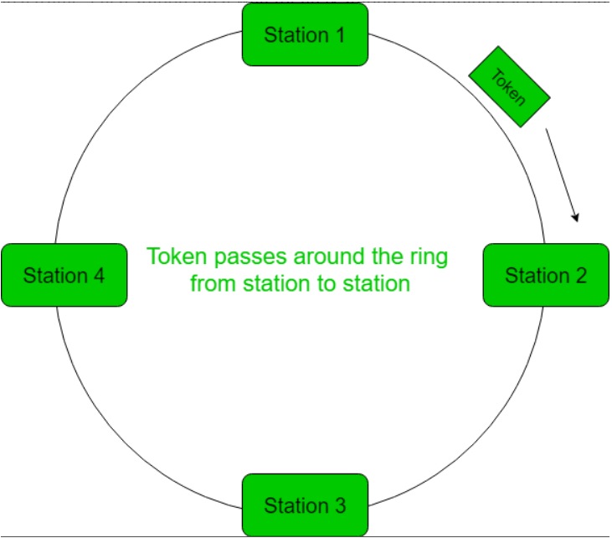

Slide 13
3. Channelization:
In this, the available bandwidth of the link is shared in time, frequency and code to multiple stations to access channel simultaneously.
Frequency Division Multiple Access (FDMA) – The available bandwidth is divided into equal bands so that each station can be allocated its own band. Guard bands are also added so that no two bands overlap to avoid crosstalk and noise.
Time Division Multiple Access (TDMA) – In this, the bandwidth is shared between multiple stations. To avoid collision time is divided into slots and stations are allotted these slots to transmit data. However there is a overhead of synchronization as each station needs to know its time slot. This is resolved by adding synchronization bits to each slot. Another issue with TDMA is propagation delay which is resolved by addition of guard bands.
Code Division Multiple Access (CDMA) – One channel carries all transmissions simultaneously. There is neither division of bandwidth nor division of time. For example, if there are many people in a room all speaking at the same time, then also perfect reception of data is possible if only two person speak the same language. Similarly, data from different stations can be transmitted simultaneously in different code languages.

